Slide 1


Chapter 2 Conceptual Data Modeling
Instructor: He Li
Notes:
In this chapter, we formalize data modeling based on the concept of business rules and describe the entity relationship data model in detail.

Slide 2
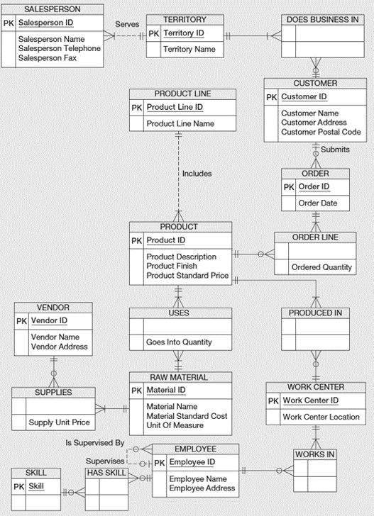
Exemplar ERD
Entity-Relationship (E-R) Model: a detailed, logical representation of the data for an organization or for a business area.
graphical representation
Entity-Relationship Diagram (ERD)
Notes:
An entity-relationship model (E-R model) is a detailed, logical representation of the data for an organization or for a business area. The E-R model is expressed in terms of entities in the business environment, the relationships among those entities, and the attributes of both the entities and their relationships. An E-R model is normally expressed as an entity-relationship diagram (E-R diagram, or ERD), which is a graphical representation of an E-R model.
An ERD usually includes entities, relationships, and attributes. We will talk about all these concepts in detail.
Let’s take a look at an example. This is the data model for a furniture company in the Microsoft Visio notation. Each box with the capital letters on the head is an entity, for example, SALESPERSON, VENDOR, SUPPLIES, etc.
The items listed inside each entity are attributes of the entity. For example, the company records the salesperson ID, name, telephone, and fax of each salesperson.
The lines connects entities are relationships. For instance, PRODUCT LINE is associated with the PRODUCT entity. The notations like circles and lines on the relationship represent cardinalities constraints.
Of course, there are also some other types such as weak entity, degree of relationships, and primary keys, which we will go through all of them in this chapter.
At the end of this chapter, you will be able to develop a complete ERD for a business, just as this shown example.

Slide 3
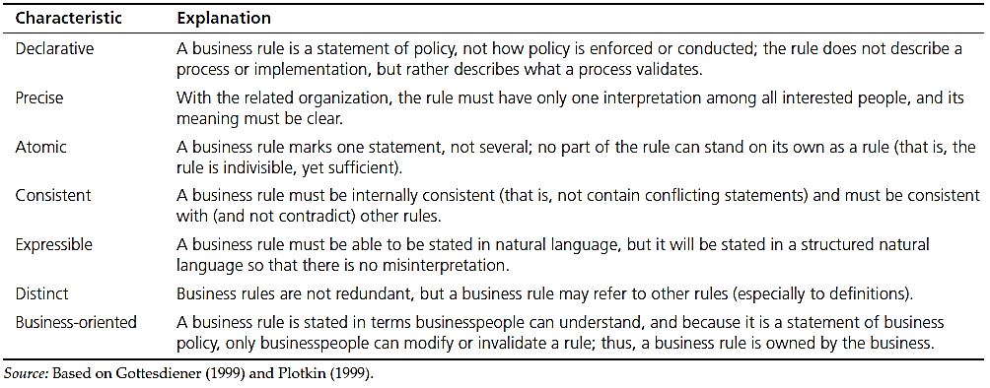
Business Rules
define or constrain some aspect of the business; derived from policies, procedures, events, functions
assert business structure; control/influence business behavior
expressed in terms familiar to end users; automated through DBMS
Notes:
Designing an ERD always starts from the business rules. In fact, documenting rules and policies of an organization that govern data is exactly what data modeling is all about. A business rule is a statement that defines or constrains some aspect of the business. It is intended to assert business structure or to control or influence the behavior of the business. For example, the policy “every student in the university must have a faculty advisor” forces data in a database about each student to be associated with data about some student advisor.
Business rules appear (possibly implicitly) in descriptions of business functions, events, policies, units, stakeholders, and other objects. These descriptions can be found in interview notes from individual and group information systems requirements collection sessions, organizational documents (e.g., personnel manuals, policies, contracts, marketing brochures, and technical instructions), and other sources. Gathering business rules requires good interviewing and listening skills.
As a database analyst, you will ask questions about the who, what, when, where, why, and how of the organization. You’ll need to be persistent in clarifying initial statements of rules because initial statements may be vague or imprecise, so this is an iterative inquiry process. Not all business rules are implemented in a database, and it is the responsibility of the database analyst to determine which business rules can be expressed through ERD and which cannot.

Slide 4
A Good Data Name is:
Related to business, not technical, characteristics
Meaningful and self-documenting
Unique
Readable
Composed of words from an approved list
Repeatable
Written in standard syntax
Notes:
Data objects must be named and defined before they can be used unambiguously in a model of organizational data. Data names refer to the names of entities, their attributes, and their relationships, which are the data objects. These names should be meaningful to the business interests and operations. In a sense, data names should be “self-documenting”, which means they should “obviously” capture the essence of the data object. It also needs to be uniquely identified, readable, composed of words that everyone understands, repeatable, and written in standard syntax.
Academic research (Salin 1990) suggests that we can develop data names by:
Preparing a definition of the data;
Removing insignificant or illegal words;
Arranging the words in a meaningful, repeatable way;
Assigning a standard abbreviation for each word;
Determining whether the name already exists and, if so, adding other qualifiers that make the name unique.

Slide 5
Data Definitions
Explanation of a term or fact
Term – word or phrase with specific meaning
Fact – association between two or more terms
Guidelines for good data definition
A concise description of essential data meaning
Gathered in conjunction with systems requirements
Accompanied by diagrams
Achieved by consensus and iteratively refined
Notes:
It is difficult to obtain a universally agreed-upon data definition. So, you may want to use multiple definitions to cover the various situations, or alternatively, use a very general definition that will cover most situations. With data definitions, as with most organizational knowledge, the person who controls the meaning of data controls the data. Thus, the definition of data is a source of organizational power.
Here are also some guidelines of what consists in a good data definition. For example, concise description of essential data meaning; gathered in conjunction with systems requirements; accompanied by diagrams; and achieved by consensus and iteratively refined.

Slide 6
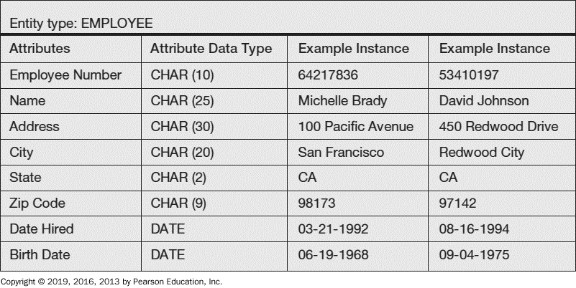
Entity: a person, a place, an object, an event, or a concept in the user environment about which the organization wishes to maintain data
Entity Type: a collection of entities that share common properties or characteristics
Entity Instance:
a single occurrence of an entity type
Notes:
An entity is a person, a place, an object, an event, or a concept in the user environment about which the organization wishes to maintain data.
It is important to distinguish an entity instance from an entity type. For example, an entity may be a particular person. But the entity type is “Person” as a concept. When you develop E-R diagrams, the boxes represent entity types, not entity instances. Although we use the word “entity” when describing E-R diagrams, what we are really talking about is “entity types”.
Look at this example, the entity type is EMPLOYEE. It has several attributes represented in the first column, along with its data type. By contrast, the third and fourth columns represent two entity instances. These would be actual records (or rows) in the final database table that implements this entity type.

Slide 7
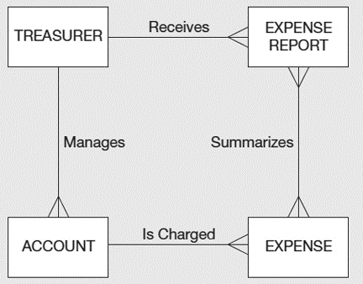
An Entity…
Should Not Be:
a user of the database system
an output of the database system (e.g., a report)
Should Be an object that …
will have many instances in the database
will be composed of multiple attributes
we are trying to model
user
output
Notes:
Another common mistake people make when they are learning to draw E-R diagrams, especially if they are already familiar with data process modeling (such as data flow diagramming), is to confuse data entities with other elements of an overall information systems model. A simple rule to avoid such confusion is that a data entity will have many possible instances, each with a distinguishing characteristic, as well as one or more other descriptive pieces of data.
So, users or outputs of a database system are not defined as entities in the ER model. As shown in this example, the treasurer is a user of the system, and the expense report is an output of the system. Neither of these entities should be represented in the database or the E-R model.
Another key to understand why this ERD might be an error is the nature of the relationship names. Receives and Summarizes refer to business activities that transfer or translate data, not to simply the association of one kind of data with another kind of data.

Slide 8
Guidelines for Naming Entities
Guidelines for Naming Entities:
Singular noun
Specific to organization
Concise, or abbreviation
For event entities, the result not the process
Name consistent for all diagrams
Guidelines for Defining Entity Types:
“An X is…”
Describe unique characteristics of each instance
Explicit about what is and is not the entity
When an instance is created or destroyed
Changes to other entity types
History that should be kept
Notes:
In addition to general guidelines about naming and defining data objects, there are some specific guidelines for naming and defining entity types. These are listed here.

Slide 9
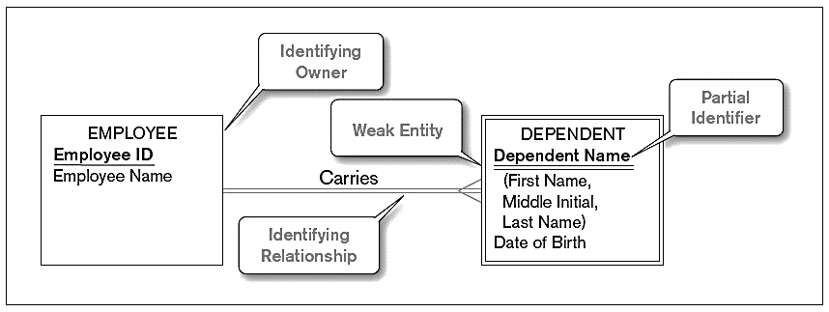
Strong v.s. Weak Entities
Weak Entity
dependent on a strong entity (identifying owner)
does not have a unique identifier (only a partial identifier)
entity box and partial identifier have double lines
Strong Entity
exists independently of other types of entities
has its own unique identifier (underlined with single line)
Notes:
Most of the basic entity types to identify in an organization are classified as strong entity types. A strong entity type is one that exists independently of other entity types, so sometimes these are called “independent” entity types. In contrast, a weak entity type is an entity type whose existence depends on some other entity type, so these are sometimes called “dependent” entity types. A weak entity type has no business meaning in an ERD without the entity on which it depends. The entity type on which the weak entity type depends is called the identifying owner.
One typical example is the identifying relationship between employee and the employer’s dependent. Note that the dependent’s identifier is only a partial identifier. The full identification requires the identifying owner’s identifier as well. Also note the double lines that distinguish the weak entity and the identifying relationship.
A tip to decide weak entities is that: in this example, if one employee instance is removed from the database, the associated dependent’s records are not necessary to keep in the database. In this case, Dependent is a weak entity.

Slide 10
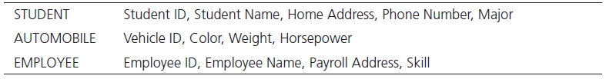
Attributes
Attribute – property or characteristic of an entity or relationship type
Classifications of attributes:
Required versus Optional
Simple versus Composite
Single-Valued versus Multivalued
Stored versus Derived
Identifier
Notes:
Each entity has a set of attributes associated with it. An attribute is a property or characteristic of an entity type that is of interest to the organization.
In naming attributes, we use an initial capital letter followed by lowercase letters. If an attribute name consists of more than one word, we use a space between the words and we start each word with a capital letter, for example, Employee Name or Student Home Address. In E-R diagrams, we represent an attribute by placing its name in the entity it describes.

Slide 11
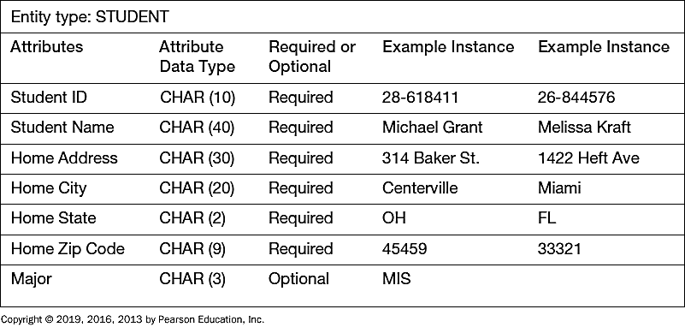
Required versus. Optional Attributes
Required: must have a value for every entity (or relationship) instance with which it is associated
Optional: may not have a value for every entity (or relationship) instance with which it is associated
Notes:
Required attributes must have a value, whereas optional attributes could be null. Here are the example of various attributes of the STUDENT entity. In this case, the student’s major is optional because a student may not yet have declared a major. All the other attributes, however, are required.

Slide 12
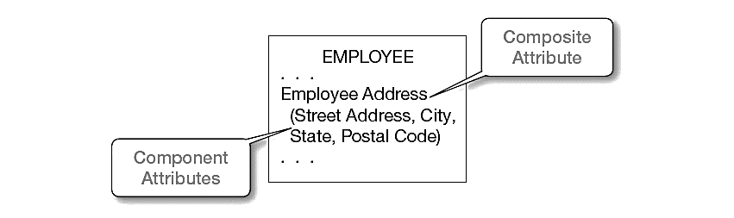
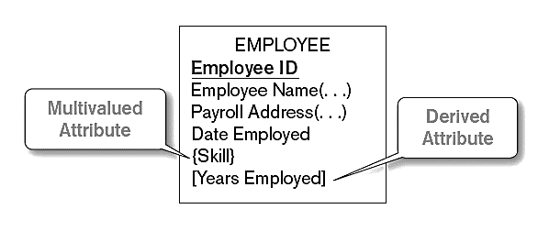
Composite Attribute:
has meaningful component parts (sub-attributes)
Derived Attribute:
Values can be calculated from related attribute values (not physically stored in the database)
Multivalued Attribute:
May take on more than one value for a given entity (or relationship) instance
Notes:
Sometimes many attributes are related to each other, such as the elements of an address. In this case they can be grouped into a composite attribute. For simplicity, we can refer to the “employee address”, but if we want more detail we can break it into street, city, state, and postal code. So, this way, we have the option to describe the attribute at a macro or at a micro level. Note the use of parentheses for encompassing the components of a composite attribute.
A multivalued attribute is not the same as a composite attribute, although novices may confuse these terms. A composite attribute is one that has many parts, such as an address composed of street, city, state, and zip. By contrast, a multivalued attribute is one that can have many different values, such as an employee being able to do many things.
Note that a derived attribute is not one that is physically stored in the database, but rather one that is calculated based on the value of another. The length of time employed, or a person’s age, are classic examples, as they are calculated based on a fixed starting point (date hired or birth date).
Attributes can be both composite and multivalued, and even also derived. So these are distinct concepts.

Slide 13
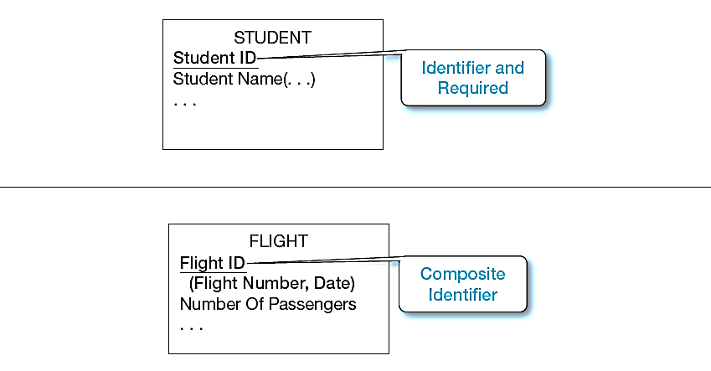
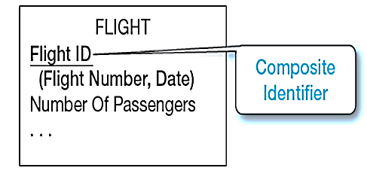
Identifiers (Keys)
Identifier (Key) – attribute(s) that uniquely identifies individual instances
Candidate Identifier – an attribute that satisfies the requirements for being an identifier
Criteria for Identifier
Choose Identifiers that: (1) will not change in value; (2) will not be null
Avoid intelligent identifiers (e.g., containing locations or people that might change)
Substitute new, simple keys for long, composite keys
simple identifier attribute
composite identifier attribute
Notes:
Every entity type should have an identifier attribute. No two instances of the entity type may have the same value for the identifier attribute. An identifier in the E-R model will eventually become a primary key in the resulting database table. Identifiers are required, so cannot be null. This value should also be constant and unique. For example, a person (employee, student, etc.) cannot rely on the first and last name to be an identifier, because people could have the same name. Rather, the identifier should be something like an employee ID or some other absolutely unique value. EmployeeID also does not change, but employee names or addresses could be changed.
Most times we have a simple identifier attribute, such as Student ID for the STUDENT entity type. Sometimes entity also can be uniquely identified by jointly using multiple attributes, such as the flight number and date, together identifies the FLIGHT entity type. If an identifier is composite, then all its component parts are required.

Slide 14
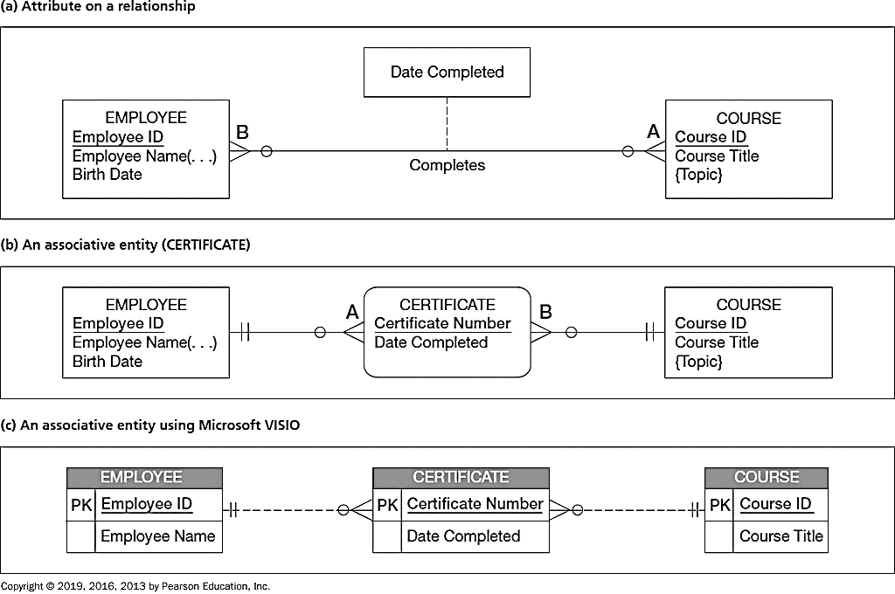
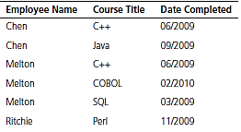
Modeling Relationships
Attributes on Relationship
(features pertaining to the association)
Relationship Types
(lines between entity types)
Relationship Instances
(between specific entity instances)
Notes:
Similar to entity type versus entity instances, a relationship type is a meaningful association between or among entity types. The phrase meaningful association implies that the relationship allows us to answer questions that could not be answered given only the entity types. Relationship instances are the records and relationships between specific entity instances.
It is probably obvious to you that entities have attributes, but relationships also can have attributes. For example, suppose the organization wishes to record the date (month and year) when an employee completes each course. This attribute is named Date Completed.

Slide 15
Associative Entity – combination of relationship and entity
When Do We Use Associative Entity?
All the relationships for the participating entity types are “many” relationships
Associative entity has independent meaning & can be identified with a single-attribute identifier
Associative entity has attributes in addition to identifier
Associative entity participates in other relationships beyond the associated relationship
Notes:
We can use Associative Entity to denote the attributes on a relationship on the ERD. An associative entity is an entity type that associates the instances of one or more entity types and contains attributes on the relationship between those entity instances.
The associative entity CERTIFICATE is represented with the rectangle with rounded corners. Most E-R drawing tools do not have a special symbol for an associative entity. The name of an associative entity is often converted from the relationship name. Also, there are no relationship names on the lines between an associative entity and a strong entity.
How do you know whether to convert a relationship to an associative entity type? Following are four conditions that should exist:
All the relationships for the participating entity types are “many” relationships.
The resulting associative entity type has independent meaning to end users and, preferably, can be identified with a single-attribute identifier.
The associative entity has one or more attributes in addition to the identifier.
The associative entity participates in one or more relationships independent of the entities related in the associated relationship.
Note that an attribute cannot be associated with a one-to-many relationship （because it will become an attribute at the one side, e.g., if one employee only can take one course, then the course complete date will be an attribute of employee）. Only could be in a one-to-one or many-to-many relationship.

Slide 16
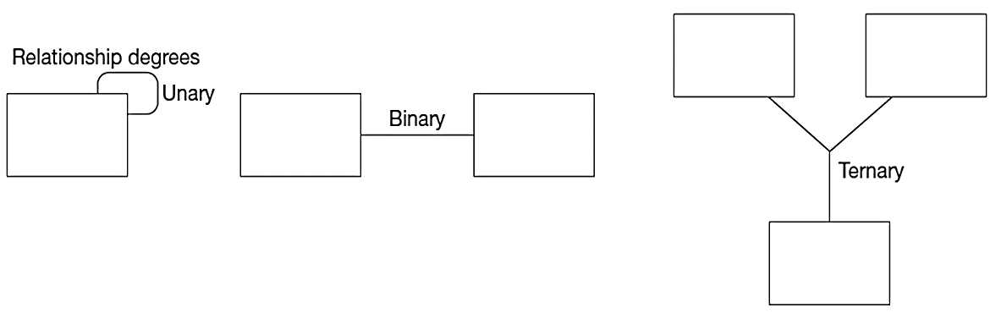
Degree of Relationships – the number of participated entity types
Unary Relationship:
entities of the same entity type related to each other
Binary Relationship:
entities of one type related to entities of another
Ternary Relationship:
entities of three different types involved in the same relationship
Notes:
The degree of a relationship is the number of entity types that participate in a relationship.
Most relationships are of binary degree (i.e., relationship of two entities). But it is possible to have any number of entities involved in a relationship. “Ternary” refers to three. If you have more than that, it is sometimes referred to generically as an “n-ary” relationship. If the entities of the same entity type related to each other, it is a unary.
Let’s look at some examples of different degree of relationships.

Slide 17
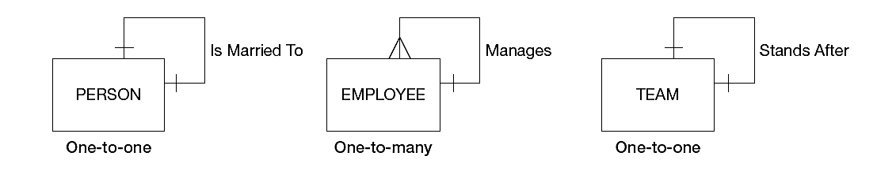
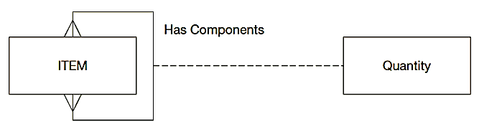
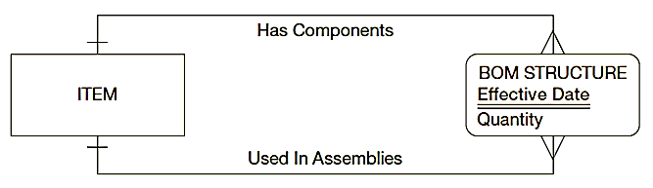
Examples of Unary Relationships
Bill-of-Materials Structure
Notes:
Examples of unary relationships include: a person marry to another person; in a company, manager supervises other employees; and a team stands after another team. In these examples, relationships occur within the same entity type, person, employee, and team.
Another example called a bill-of-materials structure. Many manufactured products are made of assemblies, which in turn are composed of subassemblies and parts, and so on.
We can represent this structure as a many-to-many unary relationship. High-level items have components of lower-level items. We also record the quantity of the components as attributes on the relationship.
The database analyst can consider converting the relationship Has Components to an associative entity, because this is a many-to-many relationship which is one of the conditions for using associative entity. We can name the entity type BOM STRUCTURE, which forms an association between instances of the ITEM entity type. A second attribute (named Effective Date) has been added to BOM STRUCTURE to record the date when this component was first used in the related assembly.

Slide 18
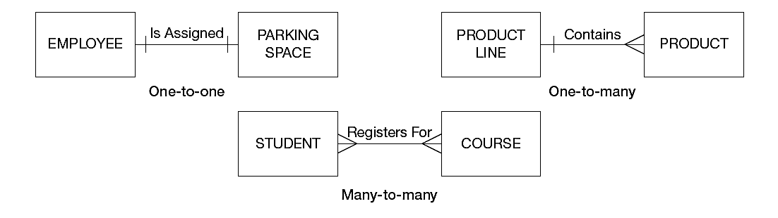
Examples of Binary Relationships
Notes:
Binary relationships are probably the most common type. For example, employee is assigned to parking space; product line contains product; and student registers for courses.

Slide 19
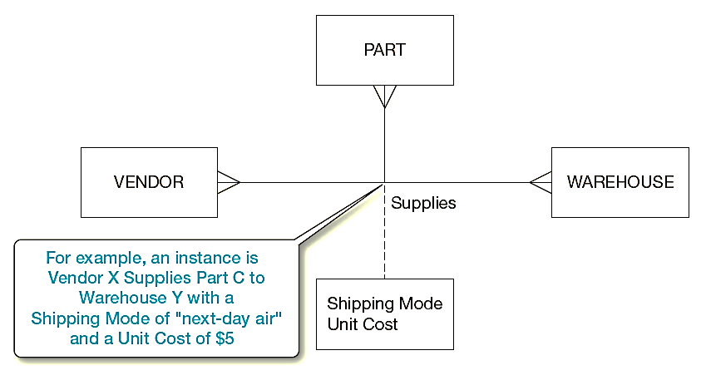
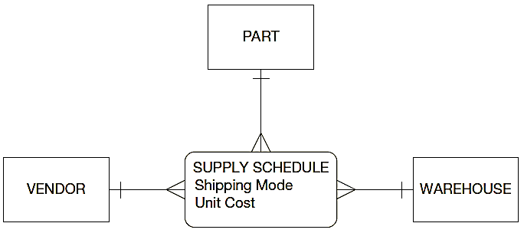
Examples of Ternary Relationships
Notes:
Here is an example for a ternary relationship. Vendors can supply various parts to warehouses. The relationship Supplies is used to record the specific parts that are supplied by a given vendor to a warehouse. Thus, there are three entity types: VENDOR, PART, and WAREHOUSE. There are two attributes on the relationship Supplies: Shipping Mode and Unit Cost. For example, one instance of Supplies might record the fact that vendor X can ship part C to warehouse Y, that the shipping mode is next-day air, and that the cost is $5 per unit.
Don’t be confused: A ternary relationship is not the same as three binary relationships. For example, Unit Cost is an attribute of the Supplies relationship. Unit Cost cannot be properly associated with any one of the three possible binary relationships among the three entity types. Thus, for example, if we were told that vendor X can ship part C for a unit cost of $8, those data would be incomplete because they would not indicate to which warehouse the parts would be shipped.
As usual, the presence of an attribute on the relationship Supplies suggests converting the relationship to an associative entity type. So, here is a rule of thumb: Convert all ternary (or higher) relationships to associative entities, as in this example. We cannot break the Supplies relationship into three binary relationships, as we have already mentioned.

Slide 20
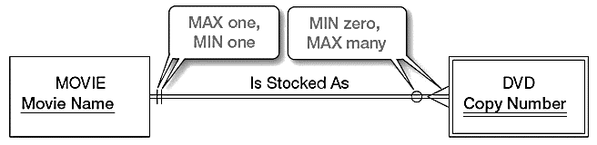
Cardinality Constraints – the number of instances of the relationship
Minimum Cardinality
If zero, then optional
If one or more, then mandatory
Maximum Cardinality
The maximum number
Notes:
There is one more important data modeling notation for representing common and important business rules. A cardinality constraint specifies the number of instances of entity A that can (or must) be associated with each instance of entity B. For example, consider a video store that rents DVDs of movies. Because the store may stock more than one DVD for each movie, this is intuitively a one-to-many relationship. Yet it is also true that the store may not have any DVDs of a given movie in stock at a particular time (e.g., all copies may be checked out).
So, we consider both minimum and maximum cardinalities.
The minimum cardinality of a relationship is the minimum number of instances of entity B that may be associated with each instance of entity A. In our DVD example, the minimum number of DVDs for a movie is zero. When the minimum number is zero, we say that entity type B is an optional participant in the relationship. In this example, DVD (a weak entity type) is an optional participant in the Is Stocked As relationship. This fact is indicated by the symbol zero through the line near the DVD entity in the diagram.
The maximum cardinality of a relationship is the maximum number of instances of entity B that may be associated with each instance of entity A. In the example, the maximum cardinality for the DVD entity type is “many”—that is, an unspecified number greater than one. This is indicated by the “crow’s foot” symbol on the line next to the DVD entity symbol in the diagram.
A relationship is, of course, bidirectional, so there is also cardinality notation next to the MOVIE entity. Notice that the minimum and maximum are both one. This is called a mandatory one cardinality. In other words, each DVD of a movie must be a copy of one and only one movie.

Slide 21
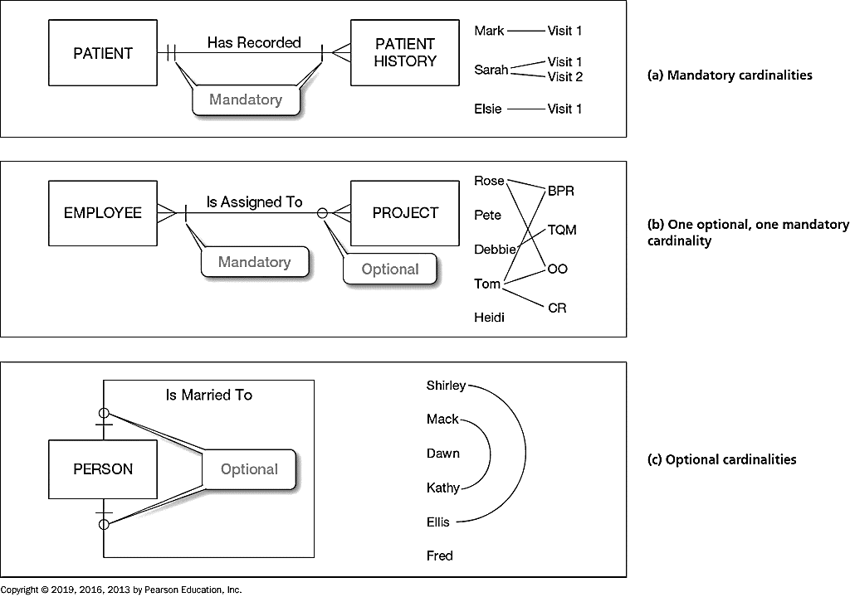
Examples of Cardinalities
Notes:
Here are more examples of cardinalities.
Note the hatch mark vs. the circle. A hatch mark illustrates mandatory cardinalities, whereas a circle represents optional cardinalities. Figure (a) indicates that each patient must have had at least one patient history (mandatory) and could have many more (many). By contrast, each patient history (visit) record must be associated with exactly one patient.
In Figure (b), from left to right direction, one employee can be assigned to many projects, but also may not be assigned to any project. Reversely, from right to left, one project must have at least one employee and can have more than one employees.
Figure (c) is a unary one-to-one relationship. A person could be married to one or no other person.
It is possible for the maximum cardinality to be a fixed number, not an arbitrary “many” value. For example, suppose corporate policy states that an employee may work on at most five projects at the same time. We could show this business rule by placing a 5 above or below the crow’s foot next to the PROJECT entity in Figure (b).

Slide 22
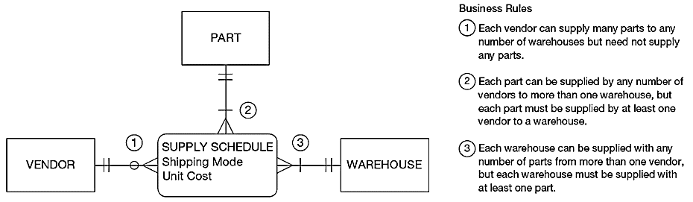
Cardinality Constraints in a Ternary Relationship
Notes:
We showed the ternary relationship with the associative entity type SUPPLY SCHEDULE in earlier slides. Now let’s add cardinality constraints to this diagram, based on the business rules for this situation. The E-R diagram, with the relevant business rules, is shown in this figure. Notice that PART and WAREHOUSE must relate to some SUPPLY SCHEDULE instance, and a VENDOR optionally may not participate. The cardinality at each of the participating entities is a mandatory one, because each SUPPLY SCHEDULE instance must be related to exactly one instance of each of these participating entity types. (Remember, SUPPLY SCHEDULE is an associative entity.)

Slide 23
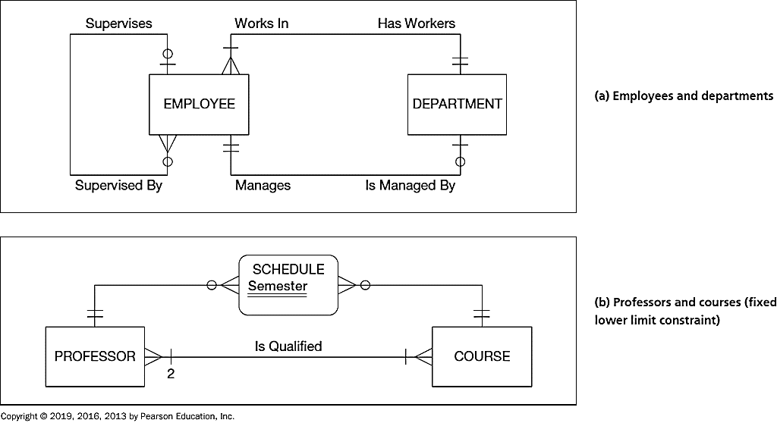
Modeling Multiple Relationships
Notes:
It is also possible for multiple types of relationships between the same two entity types.
See this example, it shows that a given employee may have exactly zero or one supervisor and could supervise any number of other employees (or none at all). We also see two binary relationships between employees and departments. First, each department must have at least one, and possibly many, employees. Each employee must work in exactly one department. Second, each department has exactly one employee as a manager, and each employee can manage at most one department, or possibly none at all.
Another example, a professor must be qualified to teach at least one course. And a course must have at least two qualified professors; this is a fixed lower limit constraint. The other relationship is actually implemented through an “associative entity” called Schedule, which has an identifier attribute called Semester. One professor may be scheduled during a semester to many courses, and vice versa.

Slide 24
Draw an ERD ….
A book is identified by its ISBN, and it has a title, a price, and a date of publication. It is published by a publisher, each of which has its own ID number and a name. Each book has exactly one publisher, but one publisher typically publishes multiple books over time.

Slide 25
Draw an ERD ….
b. A book (see above in (a)) is written by one or multiple authors. Each author is identified by an author number and has a name and date of birth. Each author has either one or multiple books; in addition, occasionally data are needed also regarding prospective authors who have not yet published any books.

Slide 26
Draw an ERD ….
c. In the context specified above in (a) and (b), better information is needed regarding the relationship between a book and its authors. Specifically, it is important to record the percentage of the royalties that belong to a specific author, whether or not a specific author is a lead author of the book, and each author’s position in the sequence of the book’s authors.

Slide 27
Draw an ERD ….
d. A book (see (a) above) can be part of a series, which is also identified as a book and has its own ISBN number. One book can belong to several sets and a set consists of at least one but potentially many books.

Slide 28
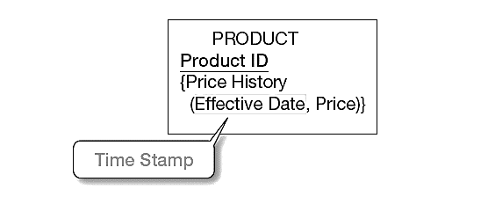
A Simple Example of Time-Stamping
Time stamp – a time value that is associated with a data value, often indicating when some event occurred that affected the data value.
The Price History attribute is both multivalued and composite.
Notes:
Database contents vary over time. With renewed interest today in traceability and reconstruction of a historical picture of the organization for various regulatory requirements such as HIPAA, the need to include a time series of data has become essential.
For example, in a database that contains product information, the unit price for each product may be changed as material and labor costs and market conditions change. If only the current price is required, Price can be modeled as a single-valued attribute. However, for accounting, billing, financial reporting, and other purposes, we are likely to need to preserve a history of the prices and the time period during which each was in effect.
Time stamps are useful for keeping historical data. In this case, we see a way of keeping track of price changes over time for products. As this figure shows, we can conceptualize this requirement as a series of prices and the effective date for each price. This results in the (composite) multivalued attribute named Price History, with components Price and Effective Date.
Can you think of how the price history could be represented as a separate entity instead of a multivalued attribute? What would be the cardinality of the relationship between product and price history? (Answer: one-to-many).

Slide 29
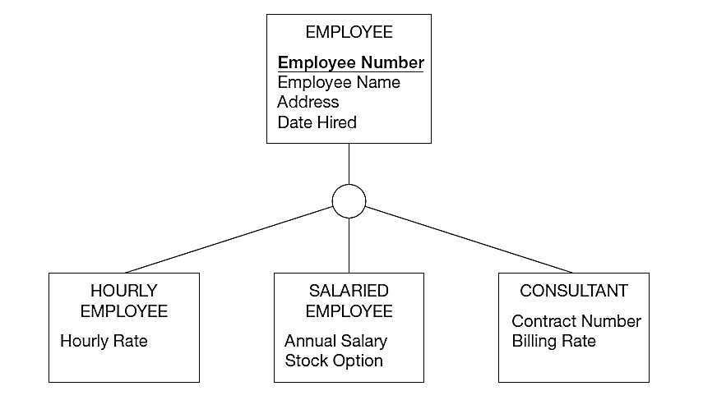
Enhanced E-R (E E R) Model
Supertype: A generic entity type that has a relationship with one or more subtypes
Subtype: A subgrouping of the entities in an entity type that has attributes distinct from those in other subgroupings
Attribute Inheritance:
Subtype entities inherit all attributes and relationships of the supertype
An instance of a subtype is also an instance of the supertype
Notes:
One of the major challenges in data modeling is to recognize and clearly represent entities that share common properties but also have some distinct properties. For this reason, the E-R model has been extended to include supertype/subtype relationships. We call it as enhanced E-R model (or EER).
A subtype is a subgrouping of the entities in an entity type. For example, EMPLOYEE is an entity type in an organization. Three subtypes of EMPLOYEE are HOURLY EMPLOYEE, SALARIED EMPLOYEE, and CONSULTANT. In this example, EMPLOYEE is regarded as the supertype. A supertype is a generic entity type that has a relationship with one or more subtypes.
Attribute inheritance is the property by which subtype entities inherit values of all attributes and instance of all relationships of the supertype. This important property makes it unnecessary to include supertype attributes or relationships redundantly with the subtypes. In this example, all employees have names, addresses, and hire dates. But only hourly employees have hourly rates, only salaried employees have salaries and stock options, and only consultants have contract numbers and billing rates. If we simply had an employee entity, then these special-purpose attributes would be irrelevant for many of the employees.

Slide 30
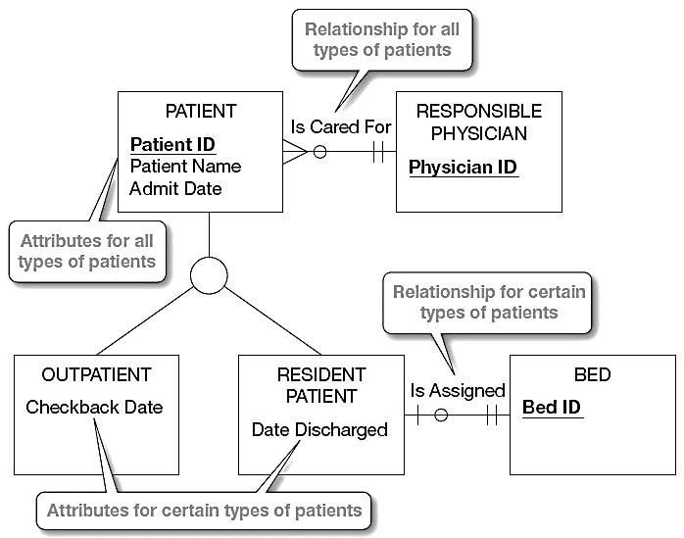
When To Use Supertype/Subtype?
Scenario 2: The instances of a subtype participate in a relationship unique to that subtype.
Scenario 1: There are attributes that apply to some (but not all) instances of an entity type.
Notes:
So, how do we know when to use a supertype/subtype relationship? Two possible scenarios:
1. There are attributes that apply to some (but not all) instances of an entity type. Like the EMPLOYEE entity type in the example earlier.
2. The instances of a subtype participate in a relationship unique to that subtype.
Here is an example of the use of subtype relationships that illustrates both situations. The hospital entity type PATIENT has two subtypes: OUTPATIENT and RESIDENT PATIENT. All patients have attributes of Patient ID, Patient Name and Admit Date. Also, every patient is cared for by a RESPONSIBLE PHYSICIAN who develops a treatment plan for the patient.
Each subtype has an attribute that is unique to that subtype. Outpatients have Checkback Date, whereas resident patients have Date Discharged. Also, resident patients have a unique relationship that assigns each patient to a bed.
In developing real-world data models, how can you recognize opportunities to exploit these supertype/subtype relationships? There are two processes—generalization and specialization—that serve as mental models in developing supertype/subtype relationships.

Slide 31
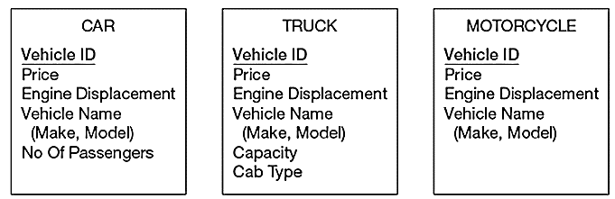
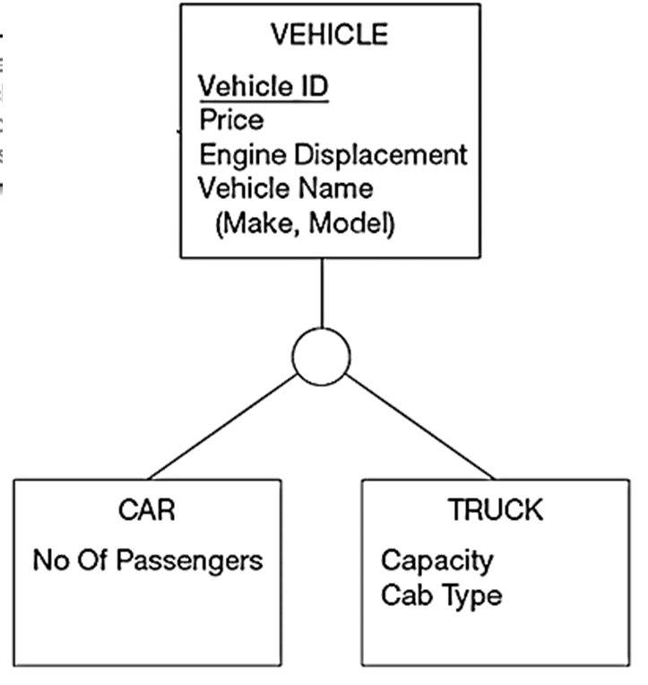
Generalization – defining supertypes from subtypes (bottom-up)
Notes:
Generalization is the process of defining a more general entity type from a set of more specialized entity types. Thus generalization is a bottom-up process.
Look at this example, we identify three separate entity types: CAR, TRUCK, and MOTORCYCLE. Then, we notice that they have a number of attributes in common: Vehicle ID (identifier), Price, Engine Displacement, and Vehicle Name (with components Make and Model). So, reinforced by the presence of a common identifier and some common attributes among them, they are really a version of a more general entity type.
We can abstract this as the supertype named VEHICLE. The left attribute No Of Passengers of CAR entity goes to the subtype CAR entity. Similarly, the subtype TRUCK has two specific attributes: Capacity and Cab Type.
Notice that the entity type MOTORCYCLE is not included in the relationship. Because there is no attribute specific to motorcycles.

Slide 32
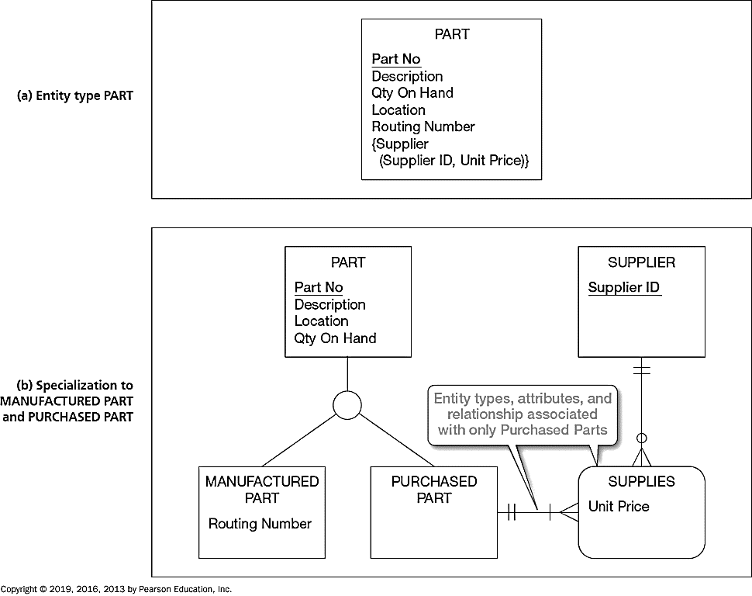
Specialization – defining subtypes from supertypes (top-down)
Internally Manufactured
Purchased from Outside Suppliers
Notes:
Specialization is a top-down process, the direct reverse of generalization. Suppose that we have defined an entity type with its attributes. Specialization is the process of defining one or
more subtypes of the supertype. Each subtype is formed based on some distinguishing characteristic, such as attributes or relationships specific to the subtype.
Assuming we have this entity PART. The identifier is Part No, and other attributes are Description, Qty On Hand, Location, Routing Number, and Supplier. Supplier is multivalued and composite because there may be more than one supplier with an associated unit price for a part.
In discussions with users, we discover that there are two possible sources for parts: Some are manufactured internally, and others are purchased from outside suppliers. Also, some parts are obtained from both sources.
Some of the attributes apply to all parts, regardless of source, like description, Qty On Hand, and Location. However, others depend on the source. Routing Number applies only to manufactured parts, whereas Supplier ID and Unit Price apply only to purchased parts.
So, PART should be specialized by defining the subtypes MANUFACTURED PART and PURCHASED PART.
In this revised EER, Routing Number is associated with MANUFACTURED PART. We also create a SUPPLIER entity type and an associative entity linking PURCHASED PART with SUPPLIER, which allows users to more easily associate purchased parts with their suppliers.
Specialization and generalization are both valuable techniques for developing supertype/subtype relationships. The technique you use at a particular time depends on several factors, such as the nature of the problem domain, previous modeling efforts, and personal preference. You should be prepared to use both approaches and to alternate back and forth as dictated by the preceding factors.

Slide 33
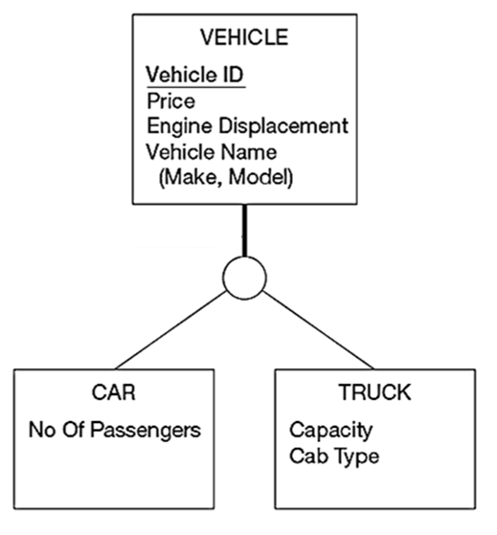
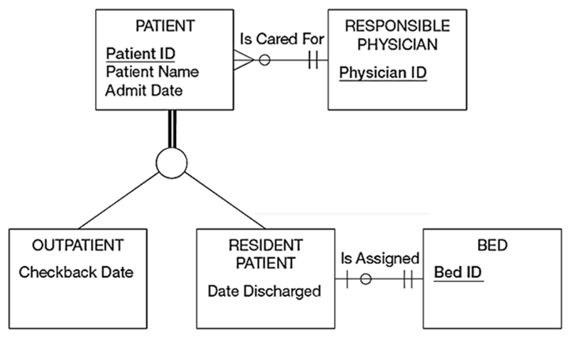
Completeness Constraints
an instance of a supertype must also be a member of at least one subtype???
Yes
No
Total Specialization
(e.g., A Patient must be either an outpatient or a Resident Patient)
Partial Specialization
(e.g., A Vehicle can be a Car, or a Truck, but does not have to be either)
Notes:
There are two types of constraints in supertype/subtype relationships: completeness constraint and disjointness constraints.
A completeness constraint addresses the question of whether an instance of a supertype must also be a member of at least one subtype. If yes, it is total specialization. For example, a patient must be either an outpatient or a resident patient. It is indicated by the double line extending from the PATIENT entity type to the circle.
In contrast, if no, we call it partial specialization. For instance, in our previous Vehicle example, motorcycle is a type of vehicle, but it is not represented as a subtype in the data model. So, a VEHICLE can be a CAR or a TRUCK, but does not have to be either.

Slide 34
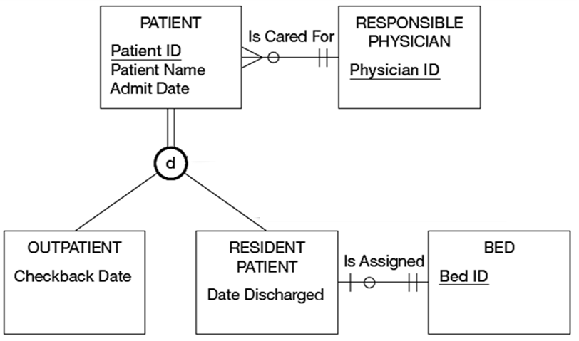
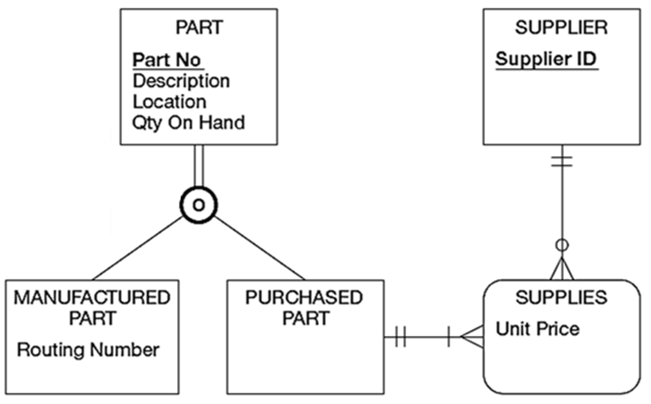
Disjointness Constraints
an instance of a supertype may simultaneously be a member of multiple subtypes???
Only One
More Than One
Disjoint
(e.g., A Patient can not be both Outpatient and Resident Patient at the same time)
Overalp
(e.g., A Part may be both Manufactured and Purchased at the same time)
Notes:
A disjointness constraint addresses whether an instance of a supertype may simultaneously be a member of more than one subtypes.
The disjoint rule specifies that if an entity instance of the supertype is a member of only one subtype. For example, a patient can’t be both a resident and an outpatient, at least not at the same time.
The overlap rule specifies that an entity instance can simultaneously be a member of two (or more) subtypes. For example, some parts could be manufactured in-house and also purchased from external suppliers.
Graphically, we can place a letter d or an o inside the category circle to represent disjoint or overlap rules.

Slide 35
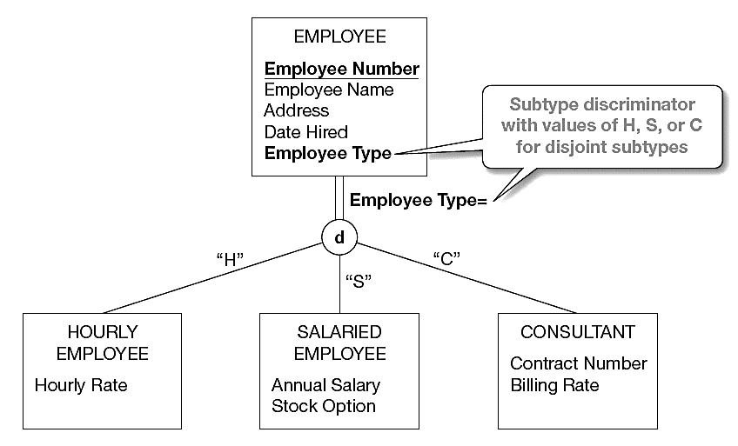
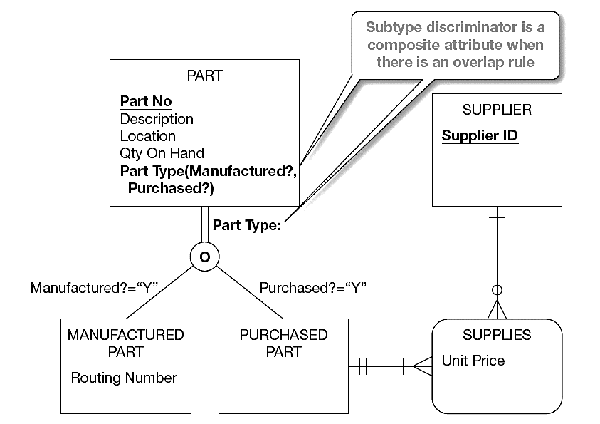
Subtype Discriminator – an attribute of the supertype whose values determine the target subtype(s)
Overlapping – a composite attribute whose subparts pertain to different subtypes. Each subpart contains a Boolean value to indicate whether the instance belongs to the associated subtype
Disjoint – a simple attribute with alternative values to indicate the possible subtypes
Notes:
Now we need a simple mechanism to implement these rules. This can be accomplished by using a subtype discriminator. A subtype discriminator is an attribute of a supertype whose values determine the target subtype or subtypes.
For the disjoint rule, we add the attribute Employee Type as the subtype discriminator, and it can have three possible values, one for each subtype.
When subtypes overlap, a slightly modified approach must be applied for the subtype discriminator. As illustrated in this example, a new attribute named Part Type has been added to PART. Part Type is a composite attribute with components Manufactured? and Purchased? Each of these attributes is a Boolean variable, Yes or No, 1 or 0, or True or False. So, there are three possible scenarios:
Manufactured = “Y” and Purchased = “Y”
Manufactured = “Y” and Purchased = “N”
Manufactured = “N” and Purchased = “Y”
Note that it is impossible for the scenario: Manufactured = “N” and Purchased = “N”. Because of the total specialization rule. At least one of these have to be “Y”.

Slide 36
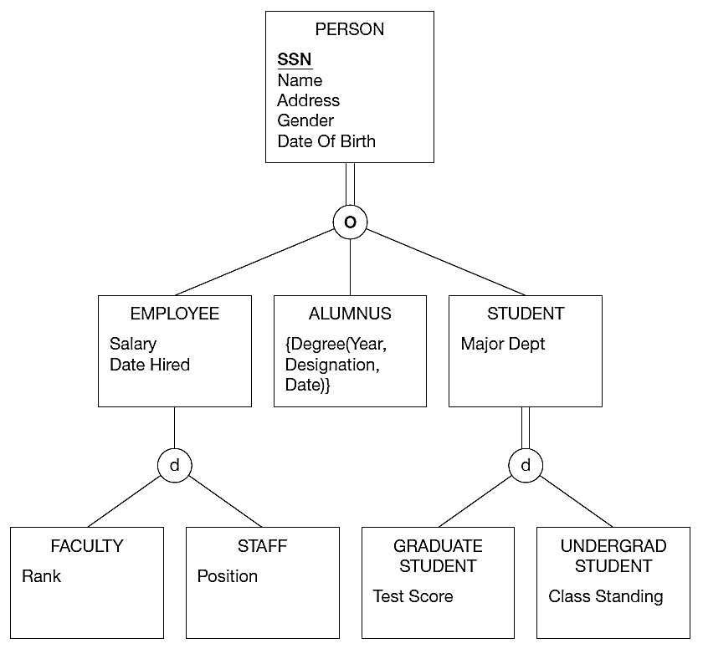
Supertype/Subtype Hierarchy
Q1: Is it possible for a person to be both an employee and a student?
Q3: Is it possible for a staff member to also be a graduate student?
Q4: Is it possible for someone to have more than one degree from this university?
Q2: Is it possible for an employee to be something other than Faculty or Staff?
Notes:
It is also possible for any of the subtypes in these examples to have other subtypes defined on it (in which case, the subtype becomes a supertype for the newly defined subtypes). A supertype/subtype hierarchy is a hierarchical arrangement of supertypes and subtypes, where each subtype has only one supertype.
Supertype/subtype hierarchies can be as deep as we want them to be. Here we see that faculty is a type of employee which is a type of person.
Let’s look at some questions for practice.
Question: Note here that a person must be either an employee, alumnus, or student. Is it possible for a person to be both an employee and a student? Why or why not?
Answer: Yes, because of the overlap rule.
Question: Can you envision what the Person’s subtype discriminator would be?
Answer: It has to be a composite attribute.
Question: Is it possible for an employee to be something other than Faculty or Staff? Why or why not?
Answer: Yes, because of partial specialization.
Question: Is it possible for an employee to be both faculty and staff?
Answer: No, because of disjoint (not overlap) under Employee.
Question: Is it possible for a staff member to also be a graduate student?
Answer: Yes, because of the overlap rule under PERSON.
Question: Is it possible for someone to have more than one degree from this university?
Answer: Yes, because Degree is a multivalued attribute.

Slide 37
Steps of Designing the EER Model
Identify the entity types
Identify the relationship types and assert their degree
Assert the cardinality ratios and participation constraints (total versus partial participation)
Identify the attribute types and assert whether they are simple or composite, single- or multi-valued, derived or not
Link each attribute type to an entity type or a relationship type
Denote the key attribute type(s) of each entity type
Identify the weak entity types and their partial keys
Apply supertype/subtype through generalization/specialization, and assert the constraints such as disjoint or overlapping, total or partial
Notes:
There are many different ways to develop an ERD or EER. Here is a suggested process.

Slide 38
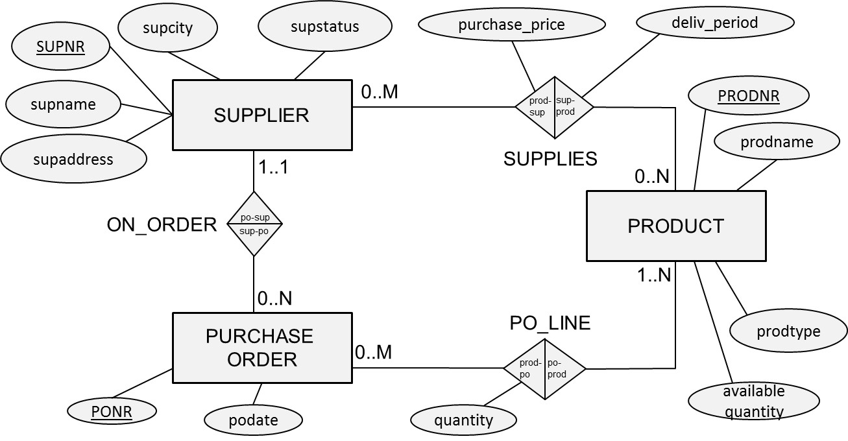
Other Types of ERD Notations

